Slide 1
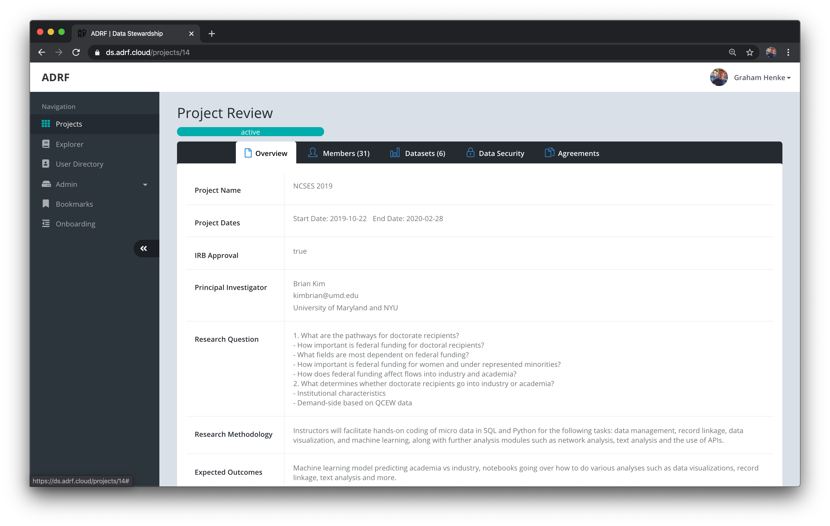
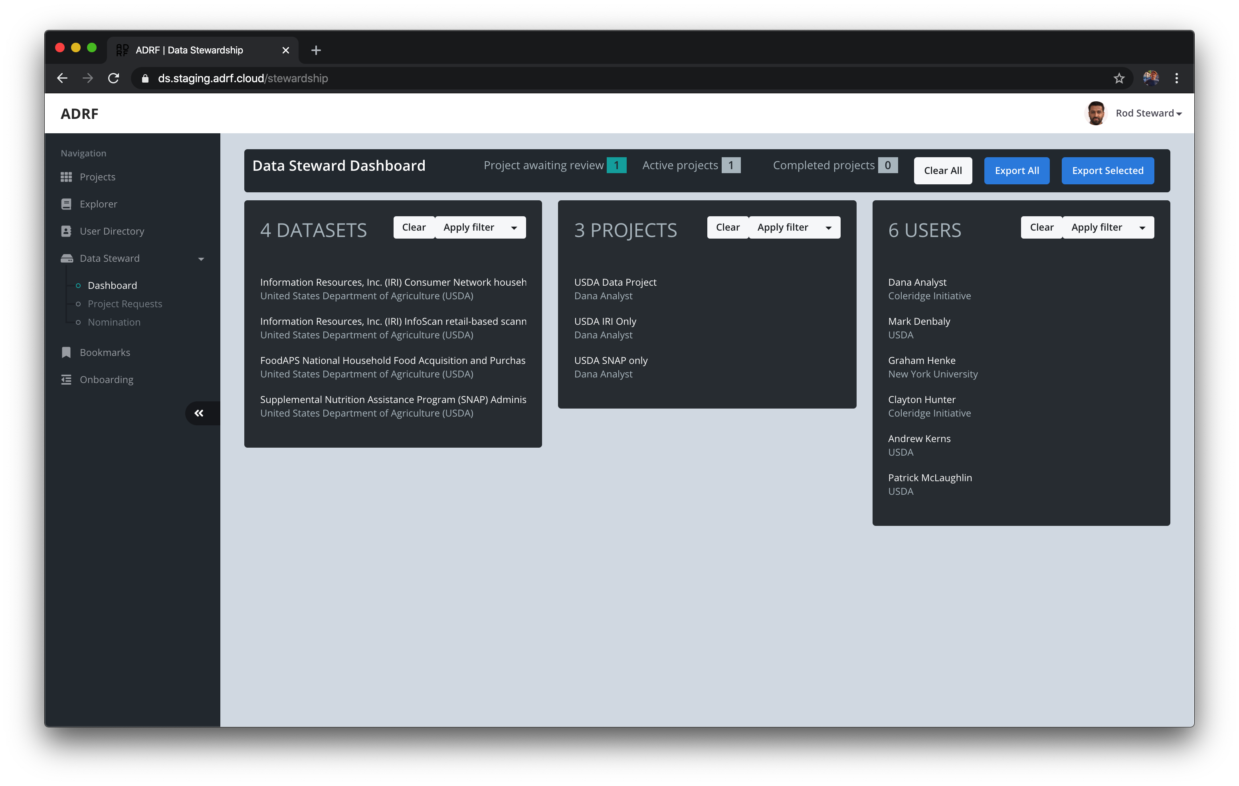
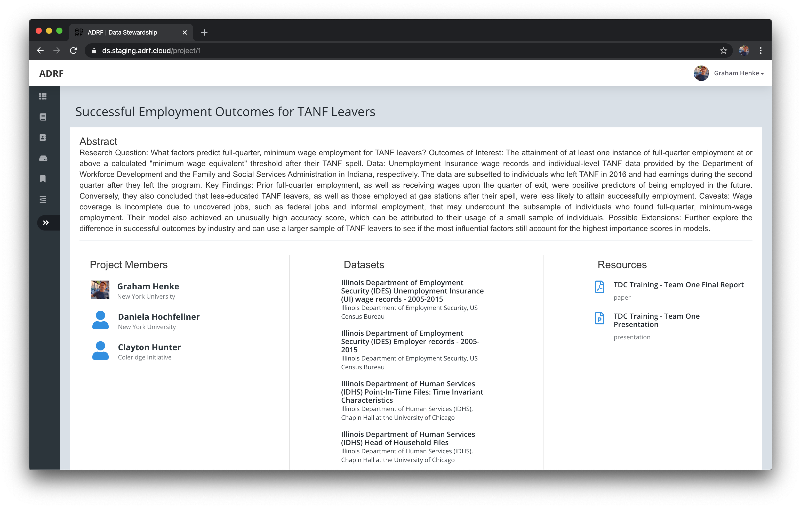
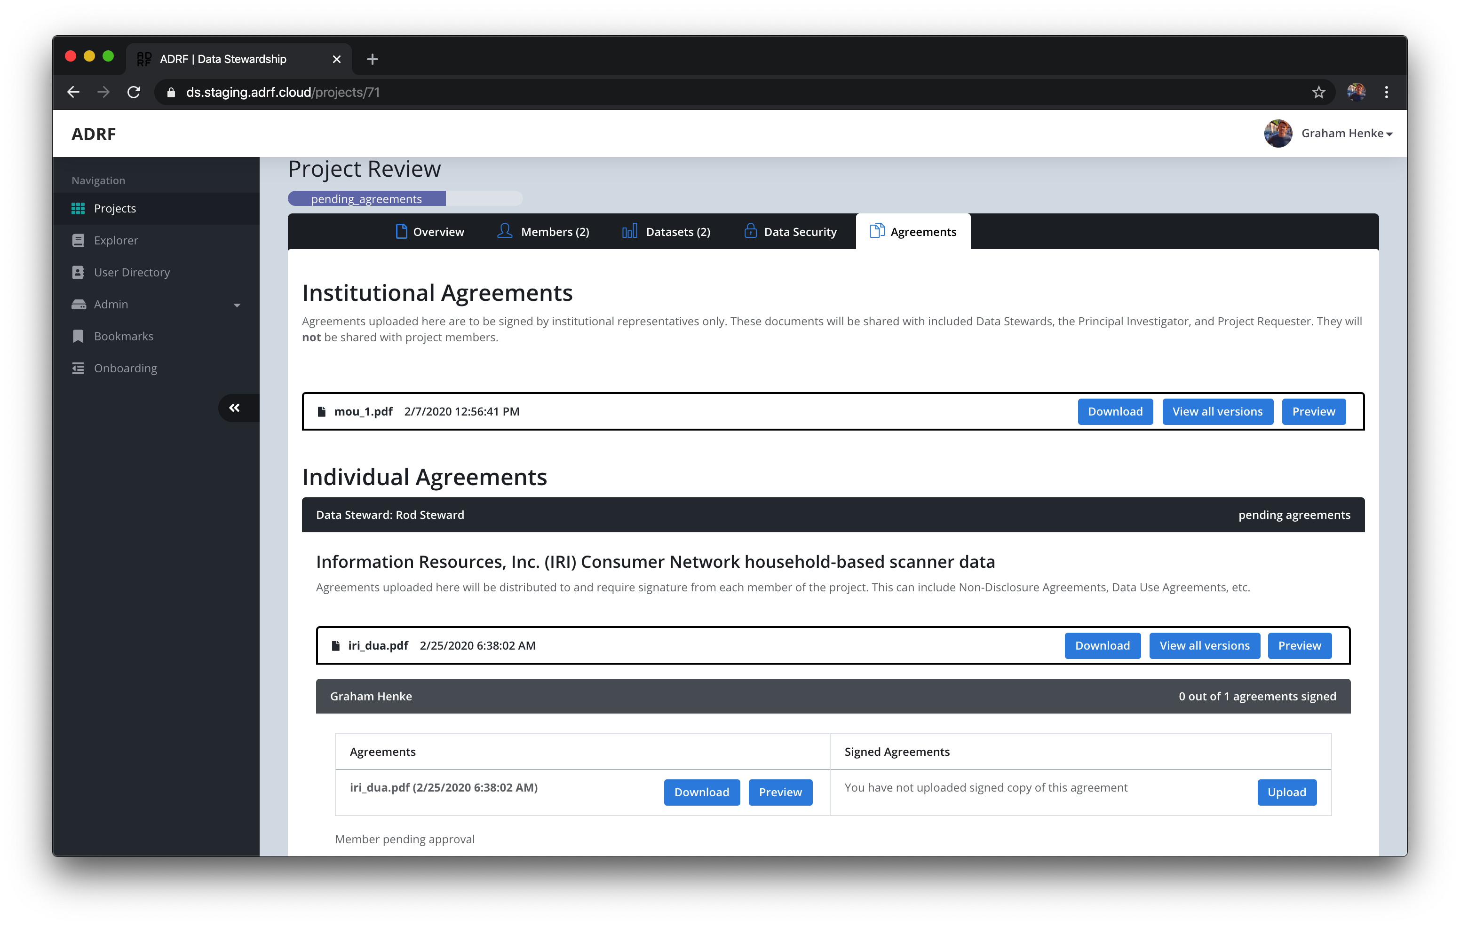
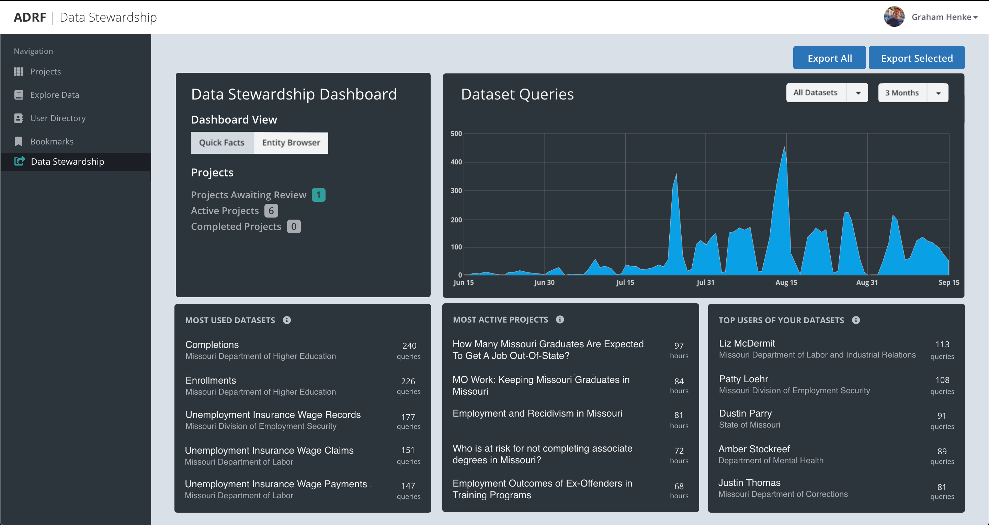
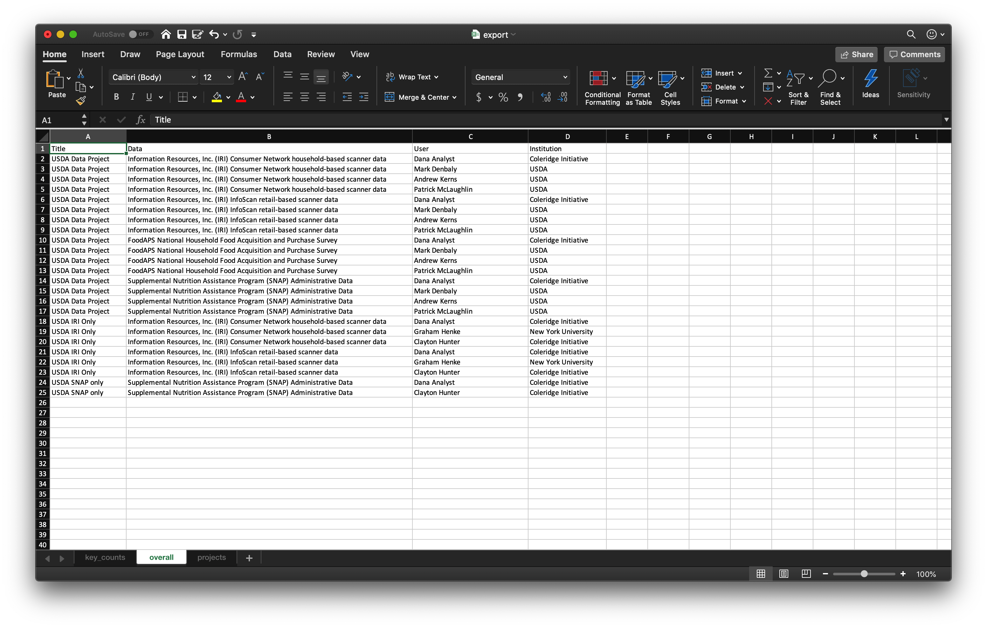

Data Stewardship in the ADRF
Managing, Monitoring, and Measuring the way datasets are used in research projects.
MANAGING
Research Project Request Workflow
Researchers can request access to datasets via the project request workflow. The appropriate Data Stewards are notified when their datasets are requested. They can then review and approve access.
MONITORING
Projects and Dataset Access
The Data Stewardship Dashboard gives Data Stewards a high-level overview as to which of their datasets researchers have access to as a part of their projects.
MEASURING
Research Papers and Presentations
Once a research project has finished, data products such as papers or presentations can be uploaded and associated with the datasets used, providing context and knowledge sharing with future researchers.
An example project request.
Datasets, Projects, and Users in the Data Stewardship Dashboard.
An example of a completed project.
Data Use Agreements
After a project has been approved, Data Stewards can attach project agreements to the project, such and Data Use Agreements or NDAs, for the researchers to sign and upload.
Dataset Usage
The Data Stewardship Dashboard will also provide high-level metrics on which datasets are most frequently used and by whom so that Data Providers can get a sense of which datasets provide the most value.
Export Metrics
Dataset usage information can be exported from the application so that Data Stewards can generate reports to share amongst key stakeholders at their agency.
Statistics on datasets queries, projects, datasets, and users.
Agreements may be required between institutions and at the individual researcher level.
Dataset usage metrics can be exported in common format like Excel and CSV.
https://coleridgeinitiative.org

